Slide 1
Accident Prone Areas in Victoria
A Supervised Learning Model
by Evangeline and Hajar

Slide 2
Understanding the problem
1
2
3
Victorian Police plan for emergency response annually especially around significant public holidays such as easter, christmas and melbourne cup.
Which Local Government Areas should the police target their resources?
Examine road crashes data over the past five years to find out:
Which factors contribute to car accidents on Victorian roads?
Which areas are prone to accidents?
Can Victorian Police employ a machine learning application to predict Local Government Areas prone to accidents based on specific factors?

Slide 3
Overview of Solution
Front End
Website with form
Flask
ML Model
feature
tuple
input features
output prediction
prediction
User space
Server space
User space
Server space

Slide 4
Data Retrieval & Cleaning

Slide 5
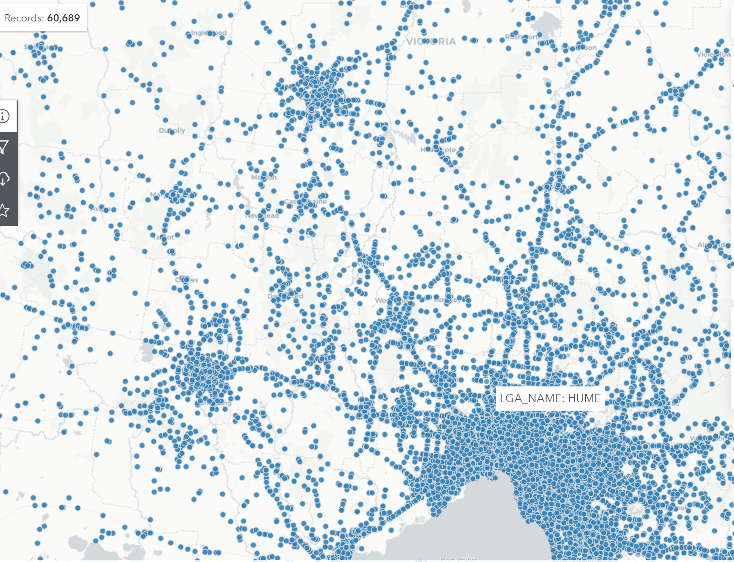
Dataset:
Data provided by VicRoads
Fatal and injury crashes on Victorian roads over 5 years, 2015 - 2019
Has 65 columns and 60,689 records
Data can be analysed based on time, location, conditions, crash type, road user type, object hit etc.
Majority of data is qualitative

Slide 6
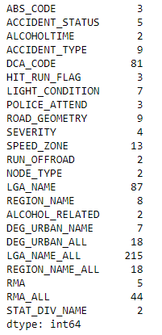
Unique values
Cleaning:
Reduced the number of columns - from 65 to 23 columns
Identified number of unique values in each column
Unsupervised Learning Model - Clustering:
Bucketing/binning: placed rare categorical values into ‘other’ category
One-hot encoding method

Slide 7
Analysis
Notes:
Evie
Thanks Hajar. Next we did some analysis on our data to help give us some insight into which models may be best.

Slide 8
Key Findings
Numerical Variables had no useful correlations
No meaningful Pearson correlations greater than 60%
Categorical Variables have very strong correlations
P-value analysis of various combinations of our categorical variables demonstrated very strong correlations.
Alcohol had too few data points to be meaningful
Only 3.6% of crashes were alcohol-related.
Geographical Variables were valuable
We determined that even the largest level of geographical resolution has strong correlations with the other variables.
Notes:
We had several key findings from this analysis.
The numerical variables provided with the data did not contain any meaningful correlations. When running pearson correlation analysis across all combinations of the numerical variables provided, there were no meaningful correlations > 60%.
We did p-value analysis on various combinations of categorical variables, including Light Condition, Speed Zone, Road Geometry v Severity, or Fatality. The largest p-value we came across was 10^-30, indicating very strong correlations.
Although alcohol has a very strong p-value indicating correlation, only 2000 of the 55000 crashes we were analysing were alcohol related, which is only 3.6% of crashes. We determined that this would not be a helpful feature to include in our model.
Finally, we determined that even the largest level of geographical resolution has strong correlations with the other variables. Which proved very useful, as while we were in testing of the model we determined that we needed some level of geographical input for our model to have any level of accuracy.
We were now ready to begin model testing.

Slide 9
Model
Notes:
Evie

Slide 10
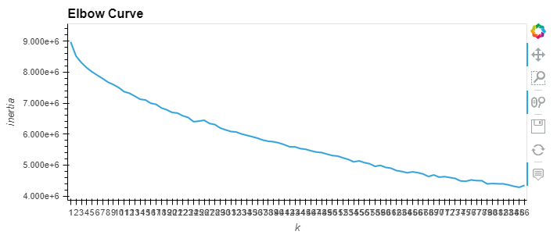
Model Testing
Supervised Learning
We tested KNeighbours, Tree and Random Forest models.
Tree and Random Forest both had over 80% accuracy with the reduced number of variables.
Supervised Learning
Unsupervised Learning
Running KMeans to determine the optimal number of clusters was unsuccessful, as the inertia graph did not have an obvious elbow, as shown below.
Unsupervised Learning
Deep Learning
We tested many variants of Neural Networks and Deep learning, with varying amounts of layers, neurons, and activation functions.
All were unsuccessful, with final accuracies of <1%.
Deep Learning
Notes:
We initially were hoping to predict a single Local Government Area (LGA), of which there were 87 used within the data. We tried clustering the data, but even up to 87 clusters, there was no elbow for us to hone in on as you can see in this graph. We changed tack and looked at predicting a larger potential area, and moved on to Supervised Learning models.
The supervised learning to predict a group of local government areas was very successful for both Tree and Random Forest, although Tree was much better for my computer’s processor. Even with a significantly reduced number of inputs, they were able to achieve over 80% accuracy. However, we learned that no meaningful level of accuracy could be achieved without some geographical data included in the models input. We therefore began including Region Name as input in all our model testing.
Our Neural Network/Deep Learning tests were unsuccessful. We were aiming to predict groups of Local Government Areas, and we have included REGION_NAME in the input data. However, over 50 epochs the accuracy of the models plummeted from their initial 50-60%, down to less than 1%. Nothing we tried showed any promise in salvaging the models.
Ultimately, we chose the Supervised Leaning Tree model as it was less taxing on our computers than the Random Forest.

Slide 11
Demo
Notes:
Evie
So we move on to the demonstration of our product.
Quite a simple setup here but very functional. Over here on the left we have a place for user inputs. They select the appropriate parameters for the crashes they’re looking into and click ‘Predict’. Then over here on the right displays a list of the Local Government Areas most at risk for those kinds of crashes.
I’ll demo that again for you.
I’ll hand back over to Hajar for our conclusion.

Slide 12
Conclusion
The model
Machine Learning model has 83% accuracy.
The accuracy may be sufficient in keeping people safe in certain LGA’s but may need to be improved to justify spending and targeting of resources.
Improvements
Combine the crash data with other data about the LGA areas such as population size, number of cars registers or socioeconomic data.
Make predictions specific to public holiday periods.
Removing the need to provide an input for all features in the form. So an employee may choose to make a prediction using only three out of eight features in the form.

